Slide 1
Priority Stow
Hawaii

Slide 2
Define
Create a priority stow program that will maximize customer satisfaction and operational efficiency.
Sales/Customer Service- Meet customer expectation, deliver exceptional service- Easier to plan the discharge and allocate proper resources accordingly to priority and minimize cost
West Coast Operation-Create a schedule where customers are accountable for in-gating freight. Expectation will help expedite loading and CNTRS will be in yard
Hawaii Operations- Easier to plan the discharge and allocate proper resources accordingly to priority and minimize cost
Neighbor Island Barges- More efficient to connect freight to neighbor islands and keep barges on schedules. Increase customer satisfaction

Slide 3
Define- Success
Improve vessel productivity by at least .25 AMGPH
Meeting customer expectation for requested container
Vessel discharge
Container availability
Having designated bays/hatches allocated to priority stow and neighbor island connections

Slide 4
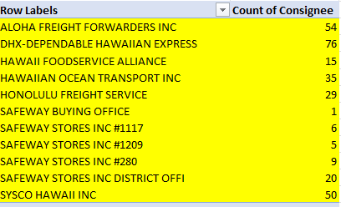
Priority Customers- (Measure)

Slide 5
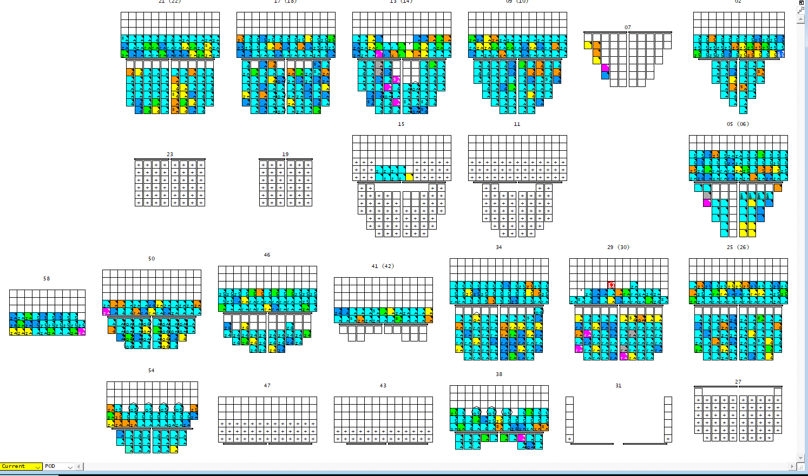
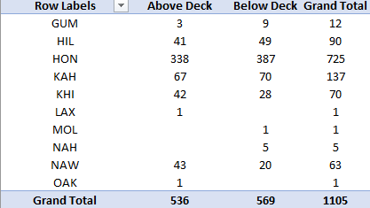
Current Layout (Measure)

Slide 6
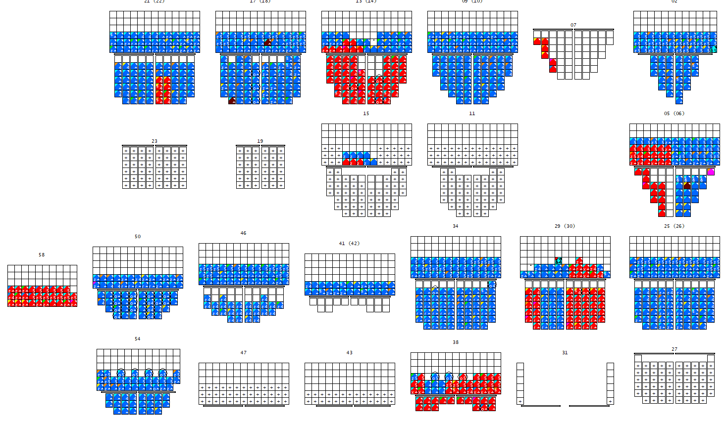
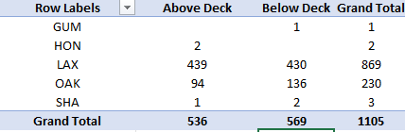
From the Coast (Measure)

Slide 7
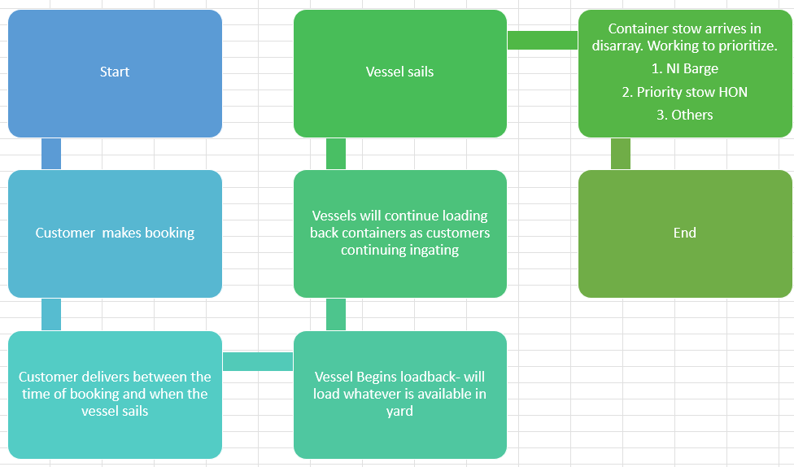
Current Process-(Analyze)

Slide 8
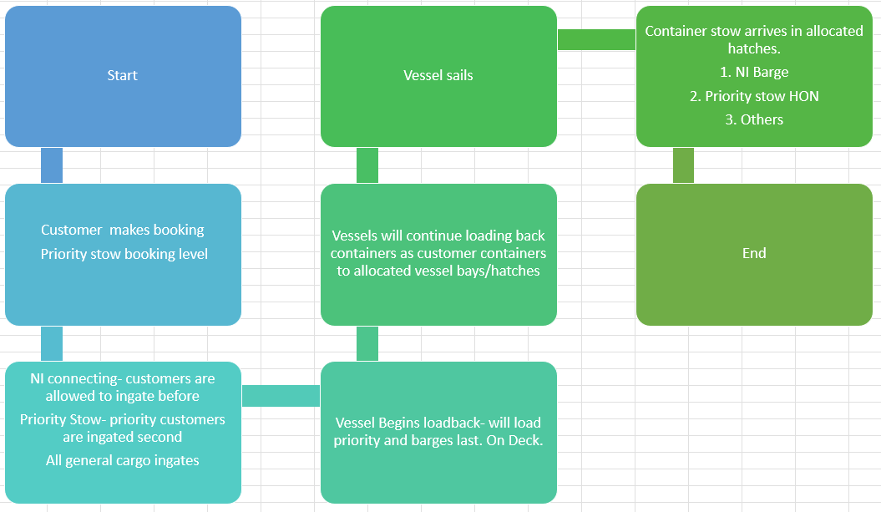
Future Process-(Analyze)

Slide 9
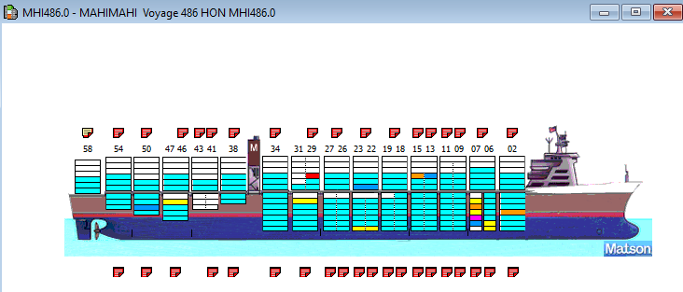
Vessel stow-(Improve)

Slide 10
(Control)
Improve vessel productivity by at least .25 AMGPH
Measure increase productivity, old process vs new process
Meeting customer expectation for requested container
Discuss with customers, how availability has been and how it has improved from past practice
Having designated bays/hatches allocated to priority stow and neighbor island connections
Review the old stow vs new stow. Look at accuracy of stow location and review WC in-gate time.
Work with customer to improve delivery time.
Work with port to see load back time

Slide 11
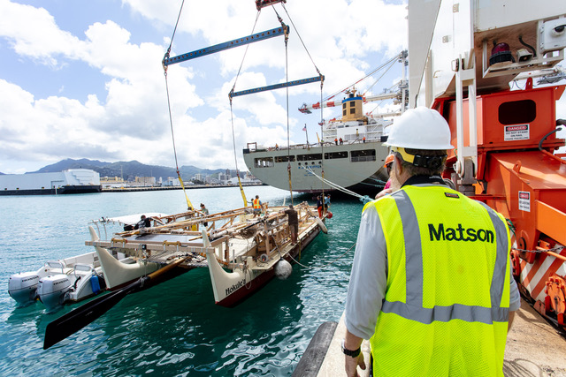
Eric Bede will now answer any questions

